Slide 1

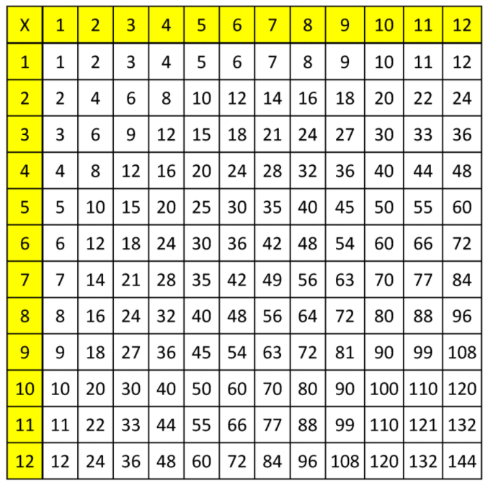
Year 4 Multiplication Tables Check (MTC) Parent Information Meeting
7 x 7
9 x 3
11 x 12
6 x 4
8 x 5
12 x 9

Slide 2

MTC
All pupils in Year 4 will undergo the Multiplication Check.
The Multiplication Check is a statutory requirement by the Government.
The window to administer the check is during Monday 2nd June 2025 to Friday 13th June 2025.
Parents will be notified of the results of their child’s Multiplication Check in the End of Year reports. There is no pass mark for the check, but the DfE will report on the number of children receiving full marks.

Slide 3
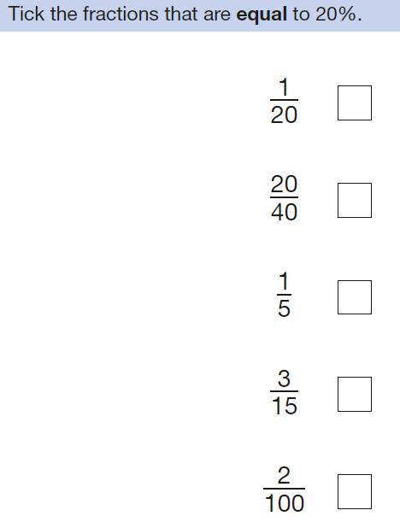
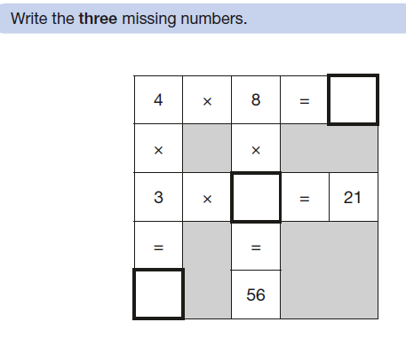
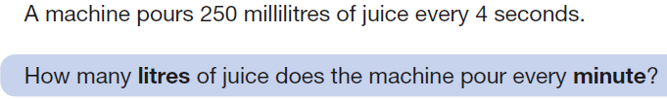
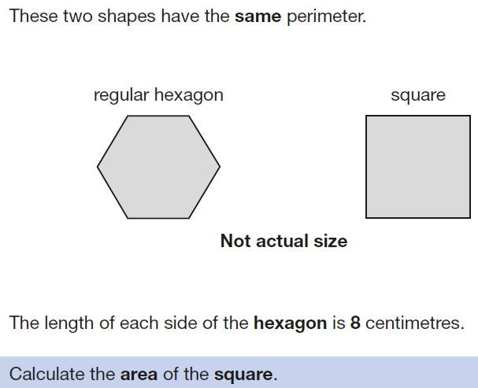
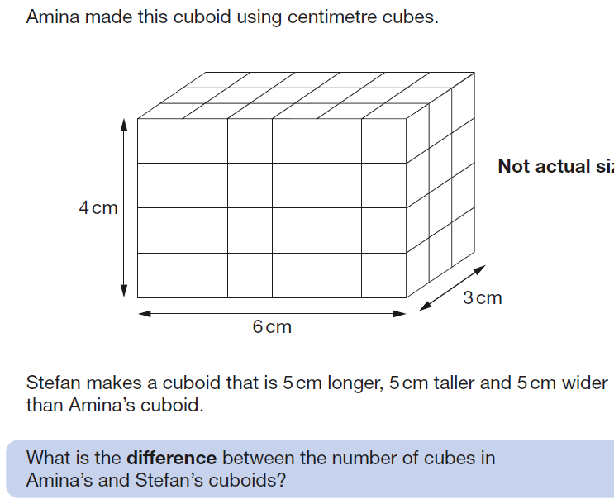
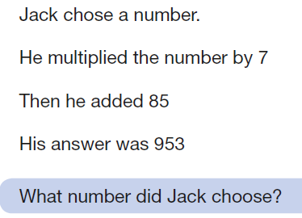
Why?
The purpose of the check is to determine whether your child can fluently recall their times tables up to 12, which is essential for future success in mathematics. It will also help us to identify if your child may need additional support.

Slide 4
What will the check look like?
It is an on-screen check consisting of 25 times table questions.
Your child will be able to answer 3 practice questions before taking the actual check.
They will then have 6 seconds to answer each question. This has been decided by the DfE because it should allow children enough time to demonstrate their recall of times tables without giving them the time to work out the answers to each question.
On average, the check should take no longer than 5 minutes to complete.
Children will be tested using a laptop, where they will have to answer multiplication questions against the clock.
Questions will be selected from the 121 number facts that make up the multiplication tables from 2 to 12, with a particular focus on the 6, 7, 8, 9 and 12 times tables as they are considered to be the most challenging. Each question will only appear once in any 25-question series, and children won't be asked to answer reversals of a question as part of the check (so if they've already answered 3 x 4 they won't be asked about 4 x 3).
Once the child has inputted their answer on the laptop they are using, there will be a three-second pause before the next question appears. Children will be given the opportunity to practise answering questions in this format before the official check begins.

Slide 5
Specific arrangements
Some children may be allotted specific arrangements, including:
• Colour contrast;
• Font size adjustment;
• ‘Next’ button (alternative to 3-second pause);
• Removing on-screen number pad;
• An adult to input answers;
• Audio version;
• Audible time alert.

Slide 6
Preparation
In school
Times tables are taught through our mathematics curriculum using the mastery approach. This teaches children the concept of multiplication, how it links to addition and division, what it looks like, what contexts it is used in and much more!
Progression of times tables
Year 1 – Counting in 2s, 5s, 10s
Year 2 – Multiplication sentences, 2 times tables, 5 times tables, 10 times tables
Year 3 – Recap on 2x, 5x, 10x, 3 times tables, 4 times tables, 8 times tables
Year 4 – 6 times tables, 9 times tables, 7 times tables, 11 and 12 times tables
Times tables fluency (the ability to recall multiplication facts quickly) are practised within class fluency sessions, focusing on children’s target times table or a mixture of facts.

Slide 7
Preparation
At home
Using times tables rockstars https://ttrockstars.com/
Maths frame https://mathsframe.co.uk/en/resources/resource/477/Multiplication-Tables-Check
https://urbrainy.com/mtc/test
Hit the button https://www.topmarks.co.uk/maths-games/hit-the-button
Counting games, quizzes, family contests, games (clock game, times tables splat)
Times tables songs
Making/recognising arrays
Top marks, daily ten, https://www.topmarks.co.uk/maths-games/daily10

Slide 8

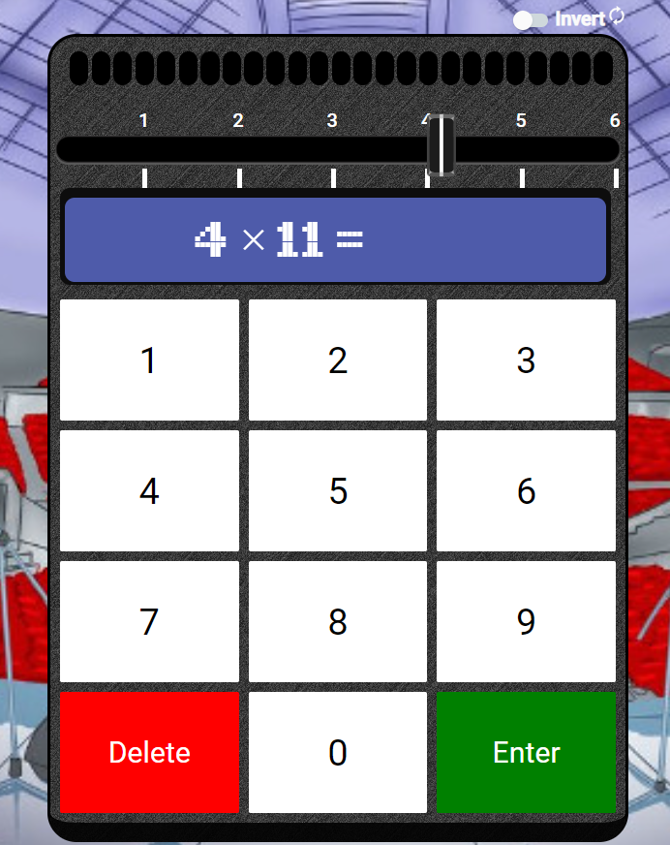
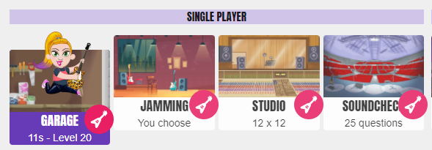

Slide 9
Questions?

